Slide 1
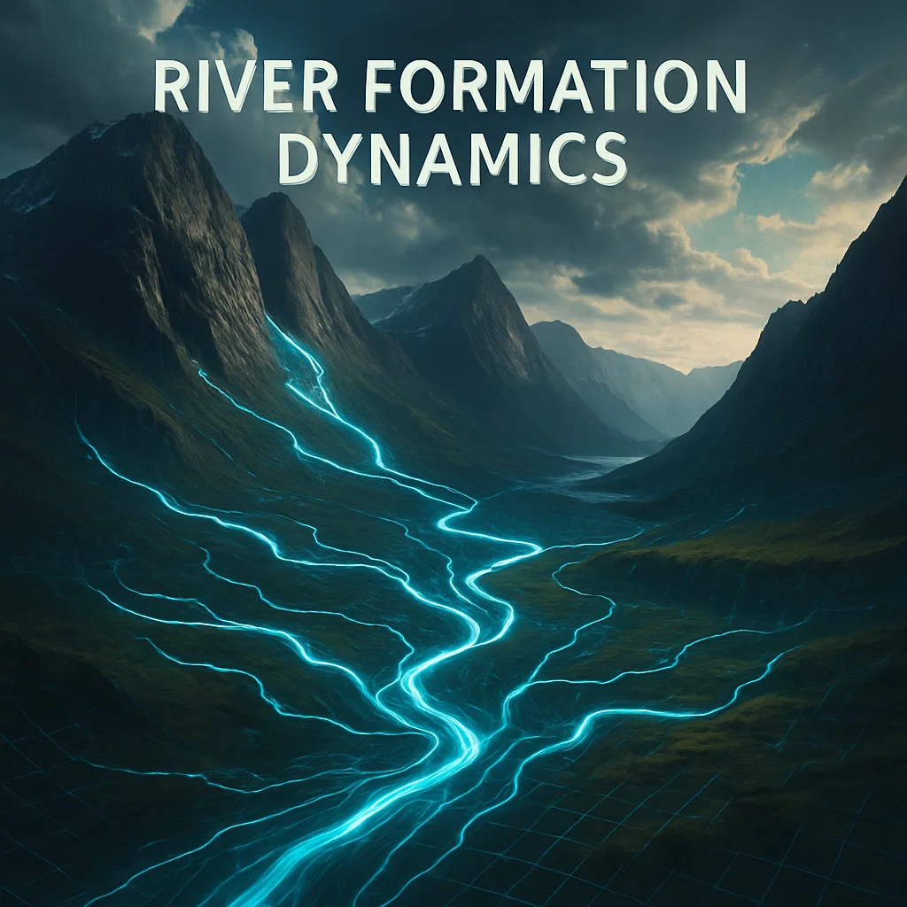
River Formation Dynamics (RFD) Optimization Algorithm
Course: Analysis of Algorithms
Name: Muhammad Anas Zakir
Roll No: 57362
Semester: 4th Semester, Spring 2025
Instructor: Muhammad Usman Sharif

Slide 2
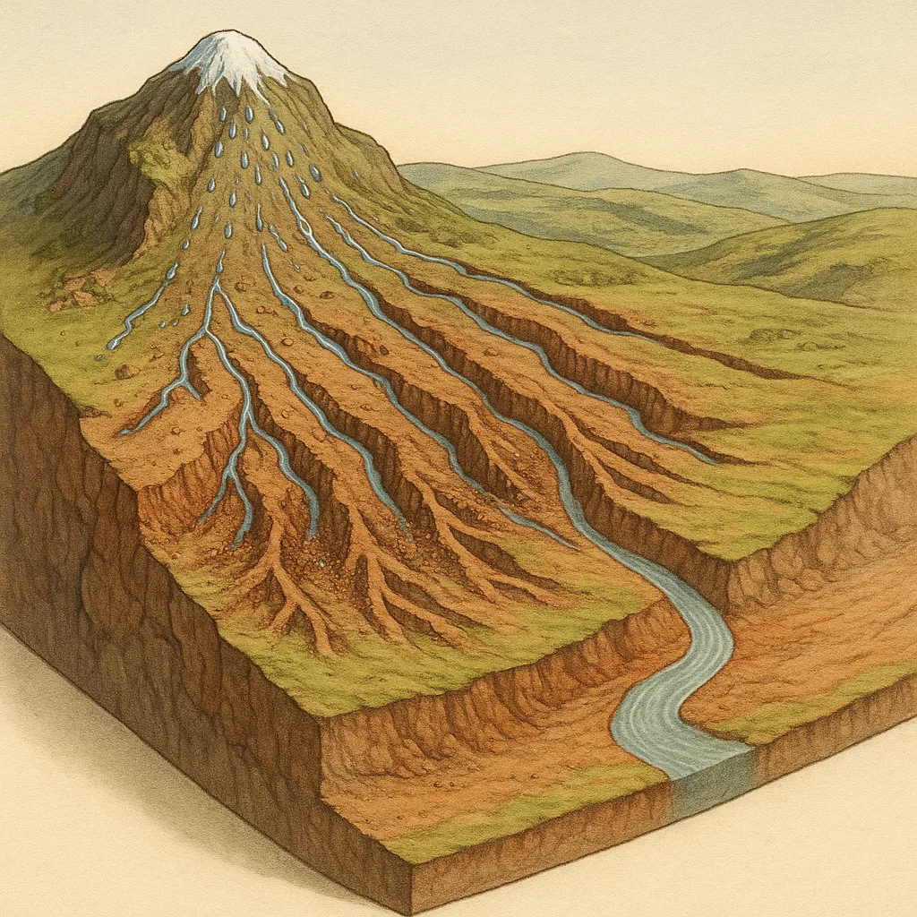
Introduction
What is RDF?
River Formation Dynamics (RFD) is a nature-inspired optimization algorithm. Like rivers flowing from high to low altitudes, it simulates water drops adjusting paths based on terrain, helping solve complex computational optimization problems.

Slide 3

Introduction
Mimics natural river flow behavior
Heuristic and adaptive approach
Competes with other metaheuristics like ACO and PSO
Suitable for dynamic and complex optimization problems

Slide 4
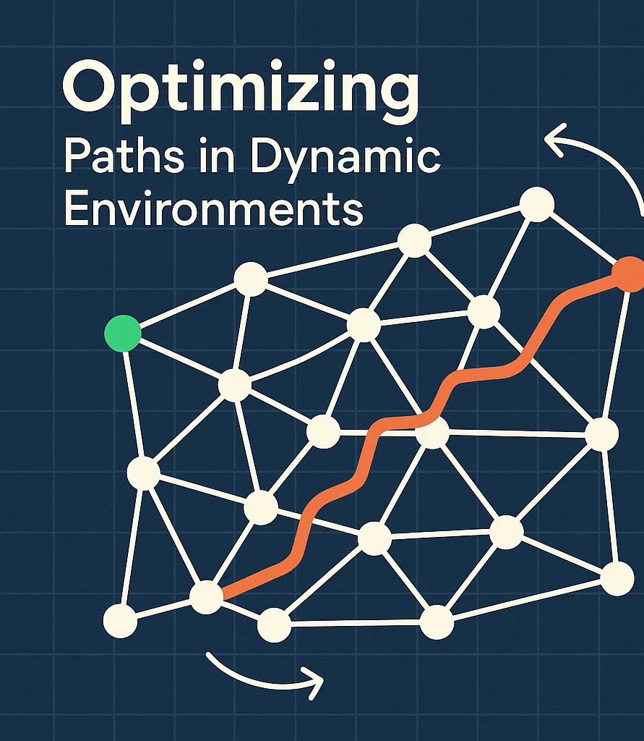
The Problem RFD Solves
Many real-world problems require finding optimal paths or decisions in complex, dynamic environments. Traditional algorithms may fail to adapt efficiently to such variability.

Slide 5
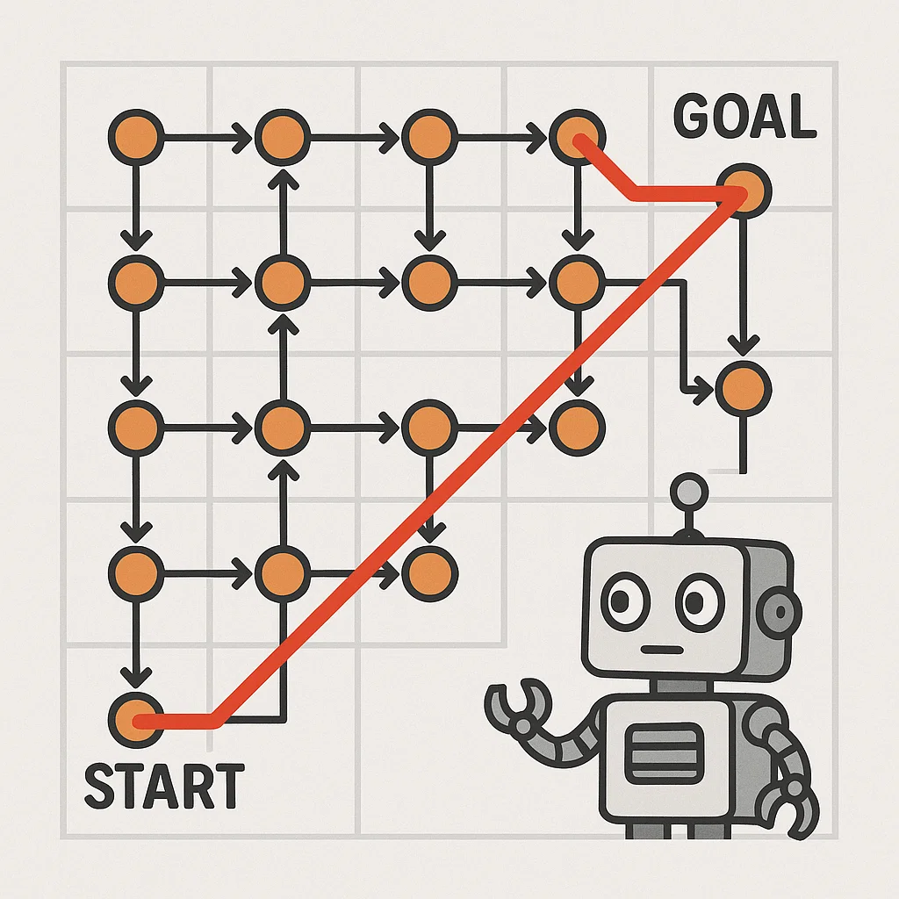
The Problem RFD Solves
Pathfinding in changing networks
Load balancing across distributed systems
Task scheduling under resource constraints
Energy-efficient routing in sensor networks
Feature selection in machine learning

Slide 6

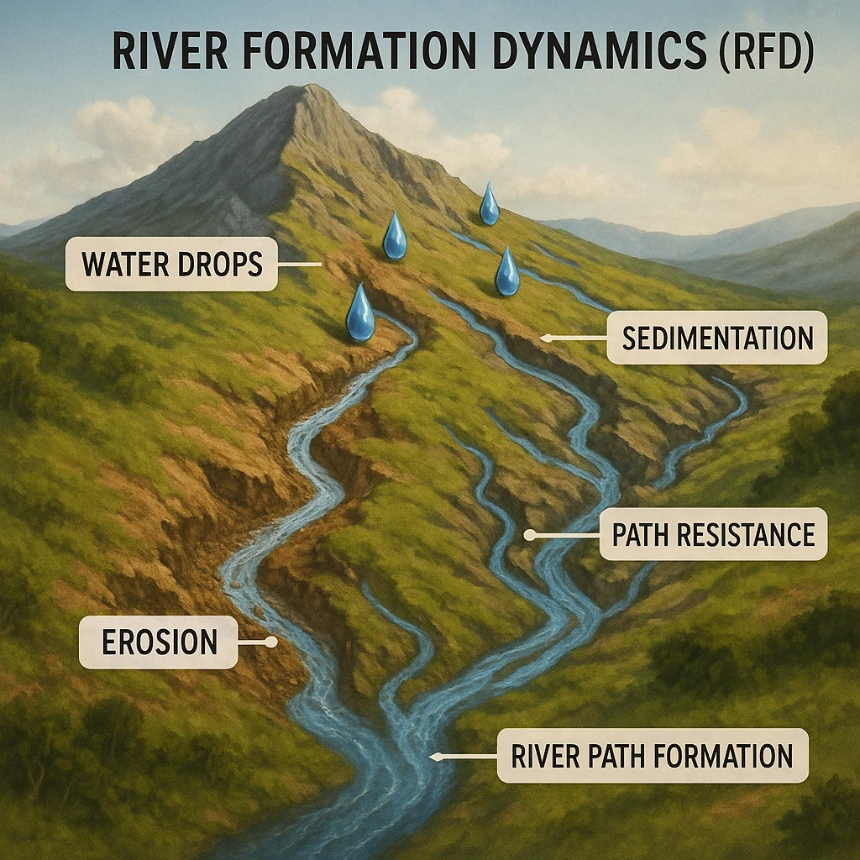
Core Concepts in RFD
The River Formation Dynamics algorithm is governed by natural principles of how water behaves. These principles are transformed into computational strategies that guide decision-making in optimization.

Slide 7
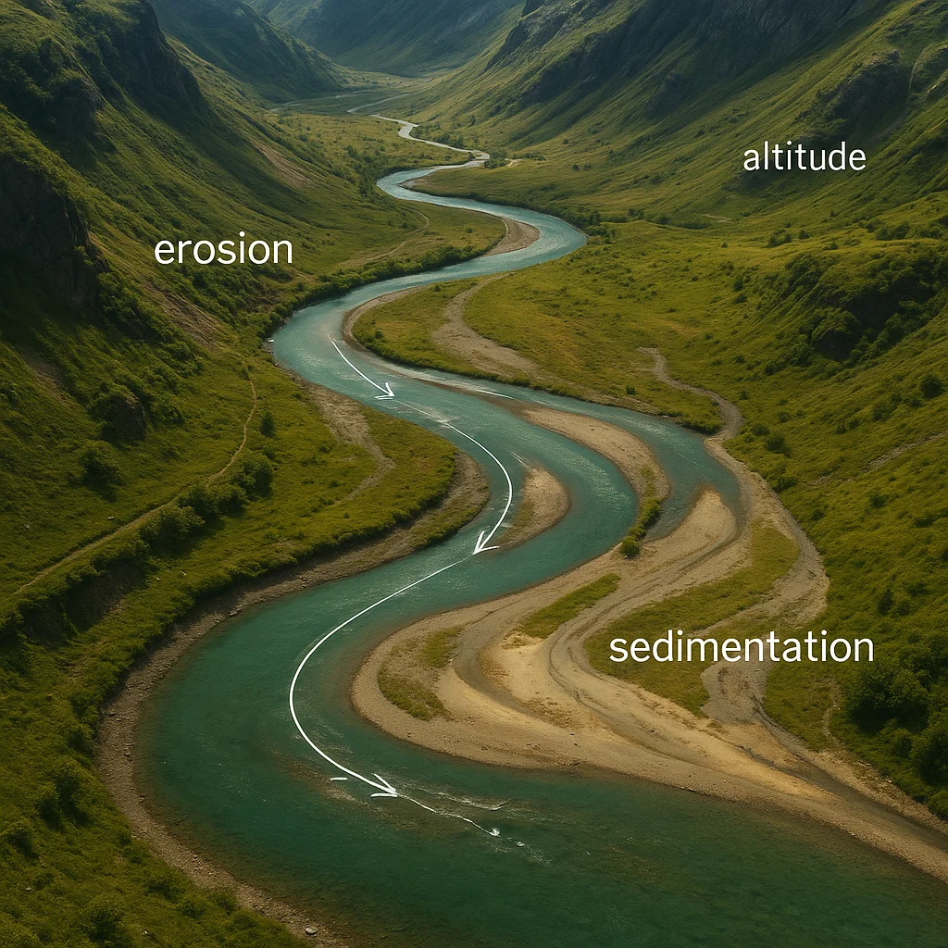
Core Concepts in RFD
Altitude: Represents the cost or difficulty of traversing a path. Lower altitude =more favorable.
Water Drop: Simulated agent that navigates the terrain, influenced by altitude differences.
Erosion: Reduces the altitude (cost) of frequently traveled paths, making them more attractive over time.

Slide 8
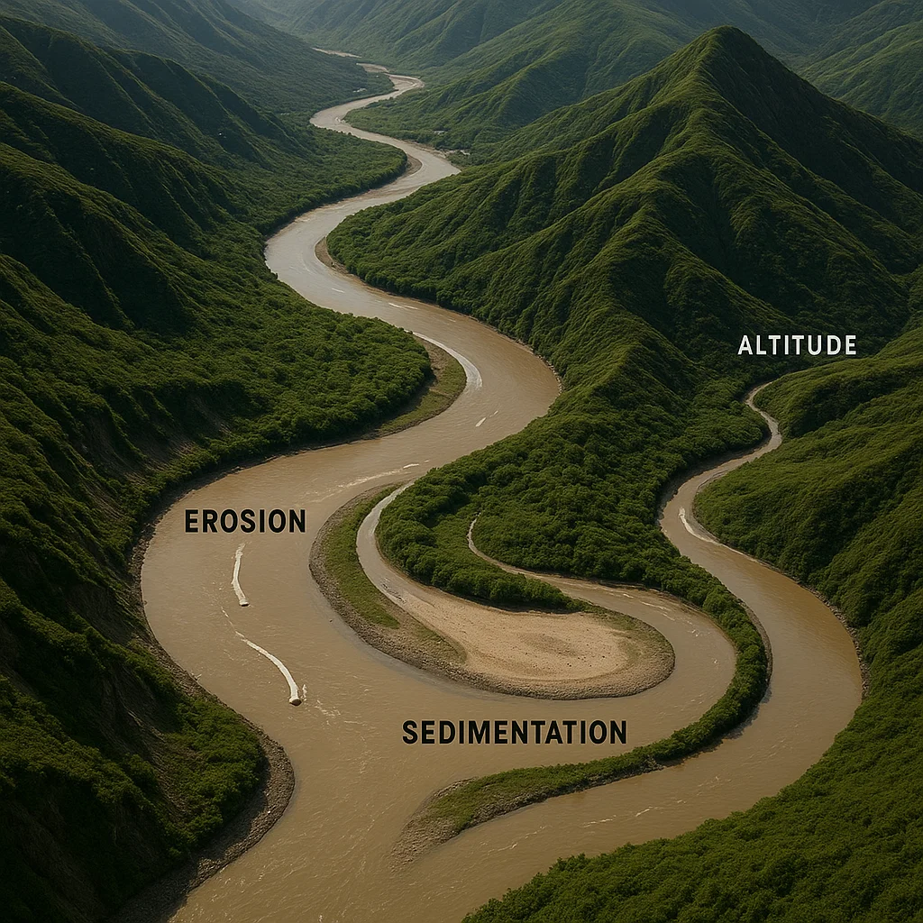
Core Concepts in RFD
Sedimentation: Increases the altitude at visited locations to avoid overcrowding and encourage path diversity.
Soil Quantity: Represents the “effort” needed to move from one node to another, adjusted via erosion/sedimentation.
Path Selection Probability: Decisions are probabilistic, with higher chance for lower-cost paths.

Slide 9
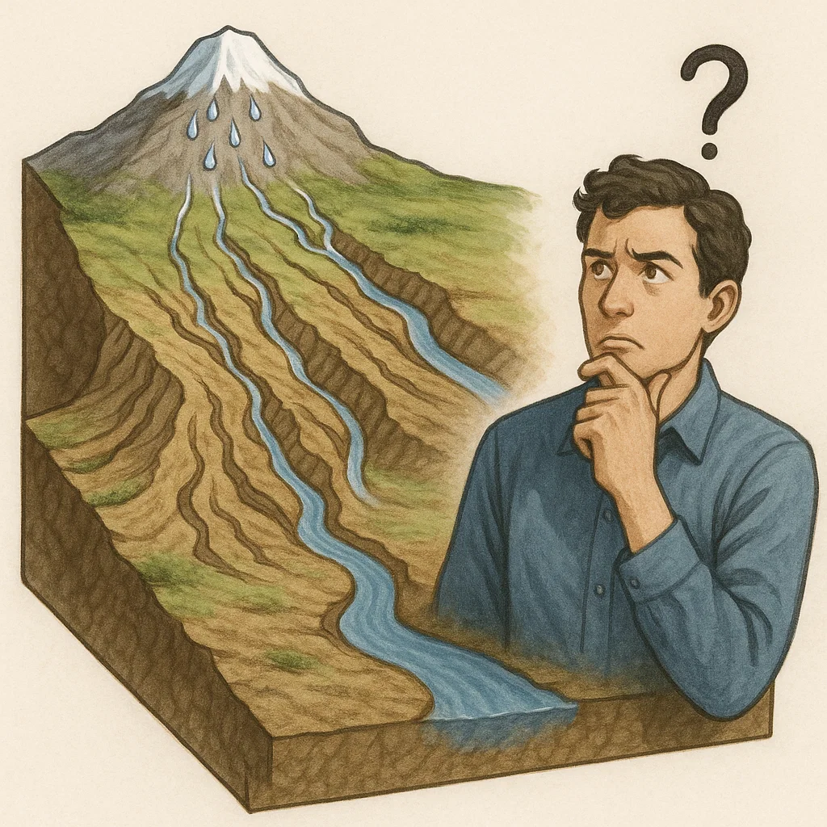
How the Algorithm Works
The River Formation Dynamics (RFD) algorithm simulates how water drops choose paths over a landscape. These drops erode the terrain and deposit sediment based on certain rules, gradually finding optimal paths — just like natural rivers do over time.

Slide 10
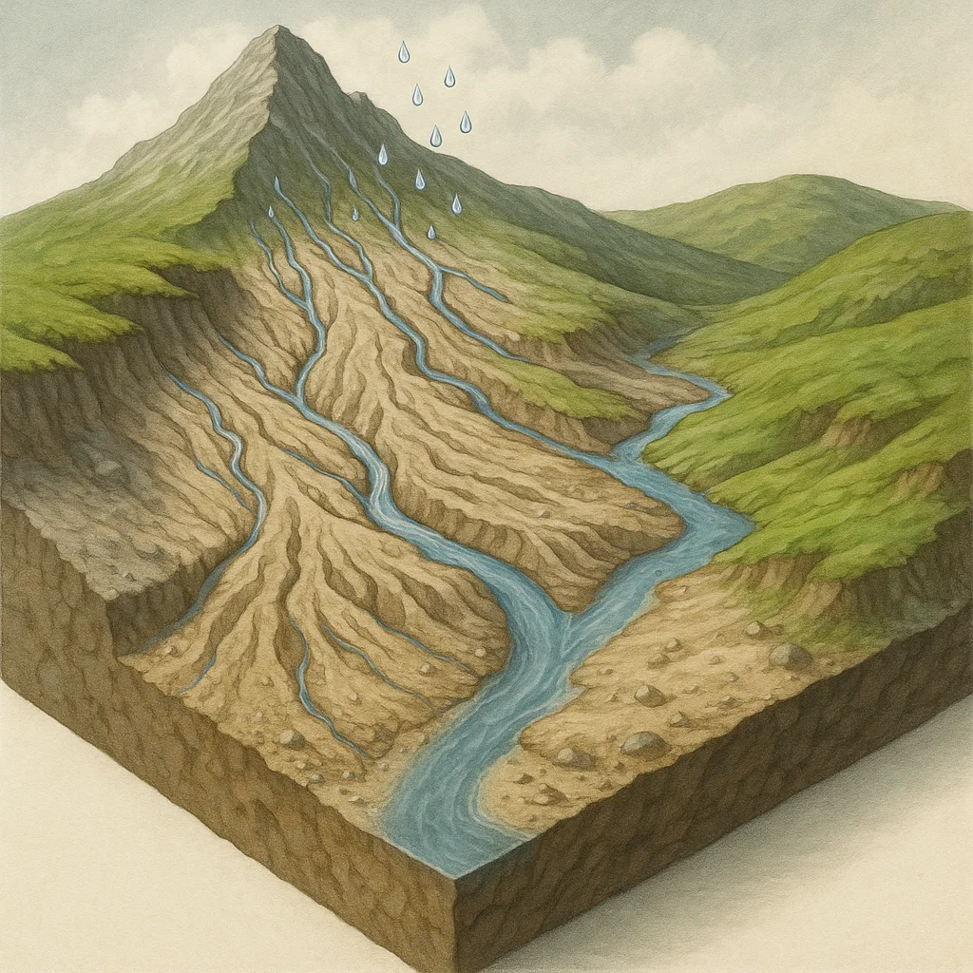
How the Algorithm Works
Water drops are released at a source (high altitude).
Each drop selects a path based on decreasing altitude and resistance.
As drops move, they erode the terrain where they pass.
Sediment is carried and deposited in lower areas.

Slide 11
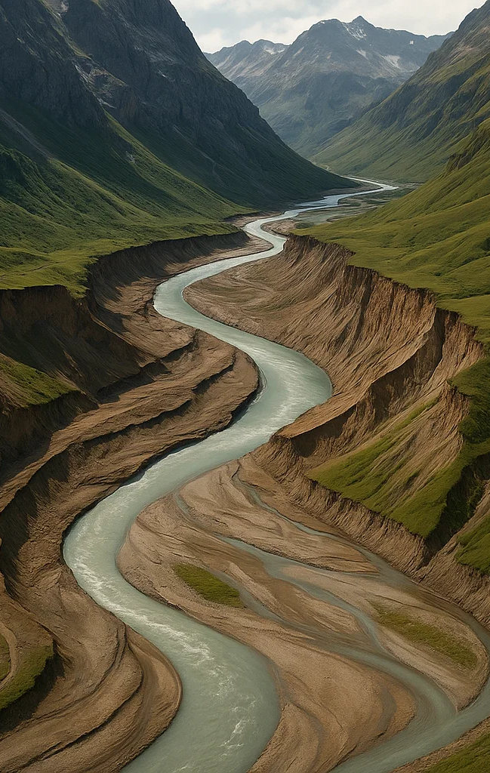
How the Algorithm Works
Sediment is carried and deposited in lower areas.
Over time, frequently used paths become more optimal.
The algorithm converges to the best (lowest-cost) solution.

Slide 12
Pseudocode
Initialize altitudes for all paths
Place drops at the start node
Repeat for several iterations:
For each drop:
While not reached destination:
Choose next node with lowest altitude
Erode the path (reduce altitude)
Sediment current node (increase altitude)
Return the best path found

Slide 13
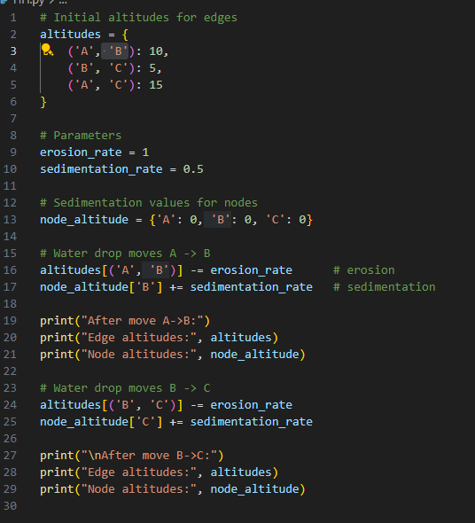
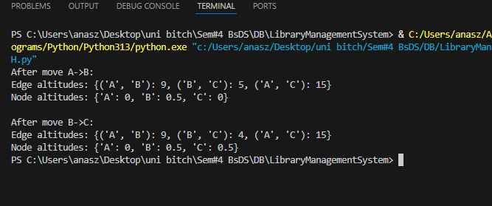
Python Implementation

Slide 14
Complexity
Time Complexity
O(I x D x N)
Where:
I = no. of Iterations
D = no. water drops
N = no. of nodes
Simplified:
O(N)

Slide 15
Complexity
Space Complexity
O(N^2 + D x N)
Where:
Altitude Matrix = O(N^2)
Drop states and histories = O(D x N)
Simplified:
O(N^2)

Slide 16

Applications of RFD in Computing
River Formation Dynamics is useful in solving a wide range of optimization problems where traditional methods struggle. Its ability to adapt to dynamic environments makes it ideal for several computing applications

Slide 17

Applications of RFD in Computing
Network Routing Optimization – Dynamically find shortest or most efficient paths.
Cloud Resource Allocation – Optimize VM placement and load distribution.
Task Scheduling – Assign limited resources to tasks with minimal delay.
Robot Navigation – Help autonomous agents find optimal movement paths.
Game AI Pathfinding – Provide alternative to A* or Dijkstra.
Feature Selection in ML – Select relevant features for better model accuracy.

Slide 18
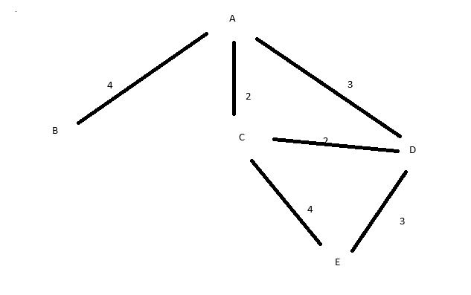
Example Case Study: Pathfinding on a Graph

Slide 19
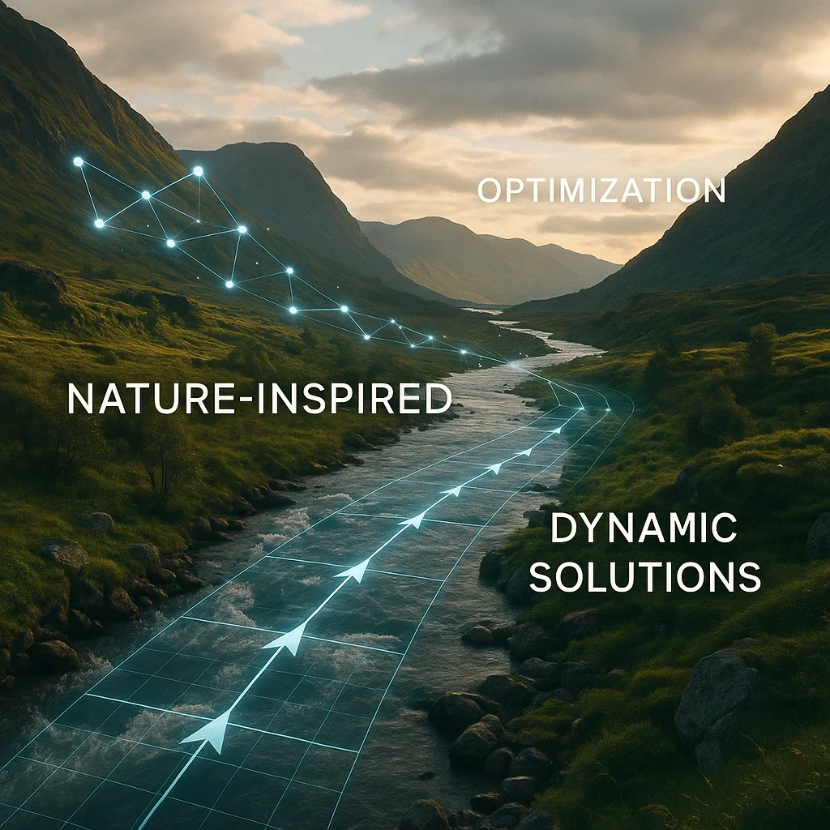
Conclusion
River Formation Dynamics (RFD) is a unique optimization technique inspired by nature's problem-solving. By simulating water drops seeking the easiest path downhill, RFD offers a fresh and effective way to tackle difficult computational problems. Its adaptability, simplicity, and ability to work in dynamic systems make it a valuable tool in the world of algorithms.

